Slide 1
ONLINE ALGORITHMS
CS5330: Randomized Algorithms
Lecture 12
07/04/2020

Slide 2
Thank You!

Slide 3
Admin stuff
No problem set for this week! Deadline for Week 11 problem set extended to Friday, April 17.
Optional problem sets for Martingales out.
Solution sketches to previous psets out. Those for Week 10 pset and optional psets out soon.
Review session for midterm tentatively scheduled on Friday, 6 pm – 8 pm, on Zoom. Is this okay?

Slide 4
Midterm 2
Focuses on the material covered in Weeks 6 to 11 (hashing, Markov chains, random walks, coupling, approximate counting, martingales). Today’s lecture not covered.
No old exams because no second midterm in earlier editions of the class.
I will put up a sample exam along with solutions before the review session on Friday.

Slide 5
Agenda
Online algorithms: the ski rental problem, paging, online bipartite matching
Online learning: online classification, regret, weighted majority.

Slide 6
What is an online algorithm?
An algorithm that needs to make a decision where the input is revealed gradually over time. The algorithm needs to act based on knowledge of the past and present but no knowledge of the future.
Online algorithm needs to be competitive with respect to optimal offline algorithm.

Slide 7


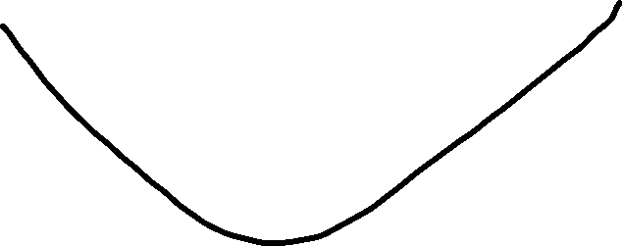
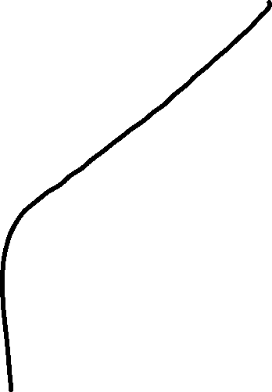
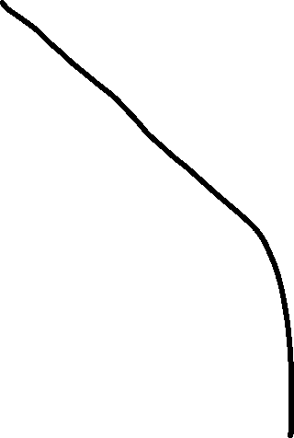
Noodle Shop Hunting Problem
?

Slide 8
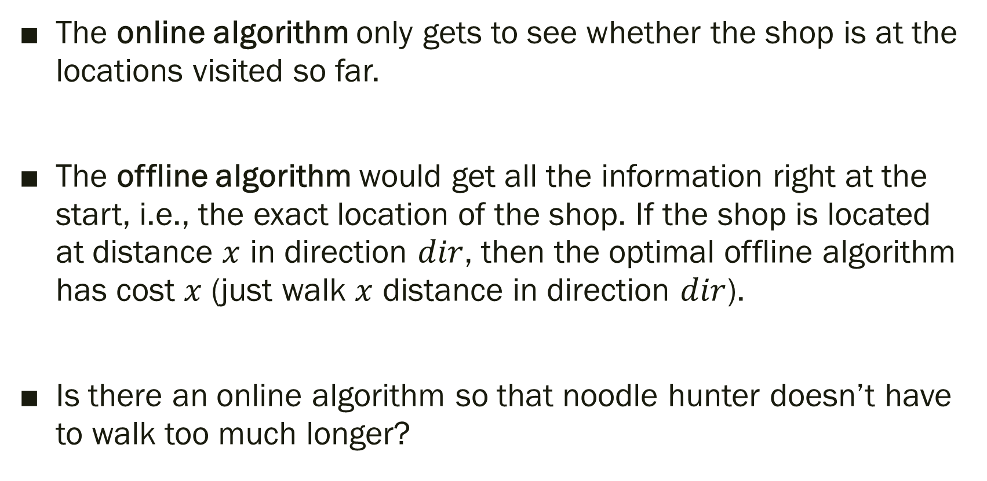
Online vs. Offline
The online algorithm only gets to see whether the shop is at the locations visited so far.
The offline algorithm would get all the information right at the start, i.e., the exact location of the shop. If the shop is located at distance $x$ in direction $dir$, then the optimal offline algorithm has cost $x$ (just walk $x$ distance in direction $dir$).
Is there an online algorithm so that noodle hunter doesn’t have to walk too much longer?

Slide 9
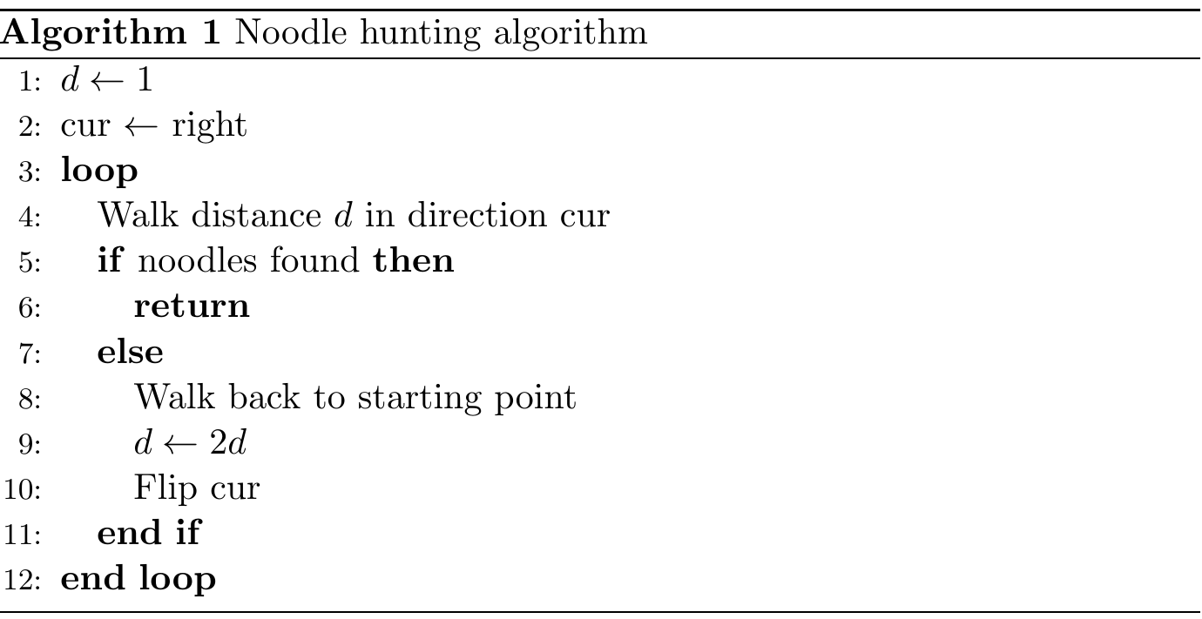

Slide 10
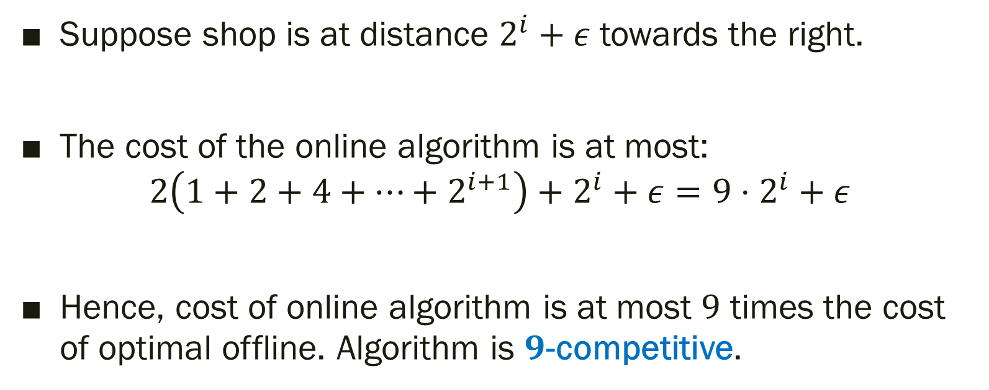
Performance of Online Algorithm
Suppose shop is at distance $2^{i}+ε$ towards the right.
The cost of the online algorithm is at most:
$$2\left(1+2+4+⋯+2^{i+1}\right)+2^{i}+ε=9⋅2^{i}+ε$$
Hence, cost of online algorithm is at most $9$ times the cost of optimal offline. Algorithm is $9$-competitive.

Slide 11
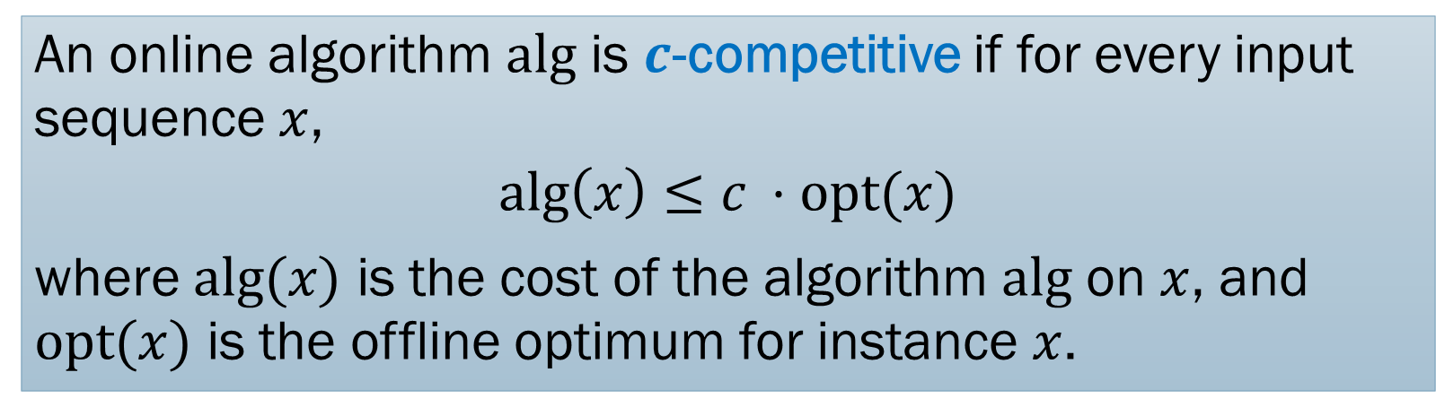
Competitive Ratio
An online algorithm $\text{alg}$ is $c$-competitive if for every input sequence $x$,
$$\text{alg}\left(x\right)≤c ⋅\text{opt}(x)$$
where $\text{alg}(x)$ is the cost of the algorithm $\text{alg}$ on $x$, and $\text{opt}(x)$ is the offline optimum for instance $x$.

Slide 12
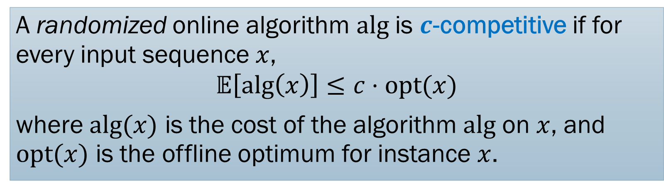
Competitive Ratio
A randomized online algorithm $\text{alg}$ is $c$-competitive if for every input sequence $x$,
$$𝔼\left[\text{alg}\left(x\right)\right]≤c⋅\text{opt}(x)$$
where $\text{alg}(x)$ is the cost of the algorithm $\text{alg}$ on $x$, and $\text{opt}(x)$ is the offline optimum for instance $x$.

Slide 13
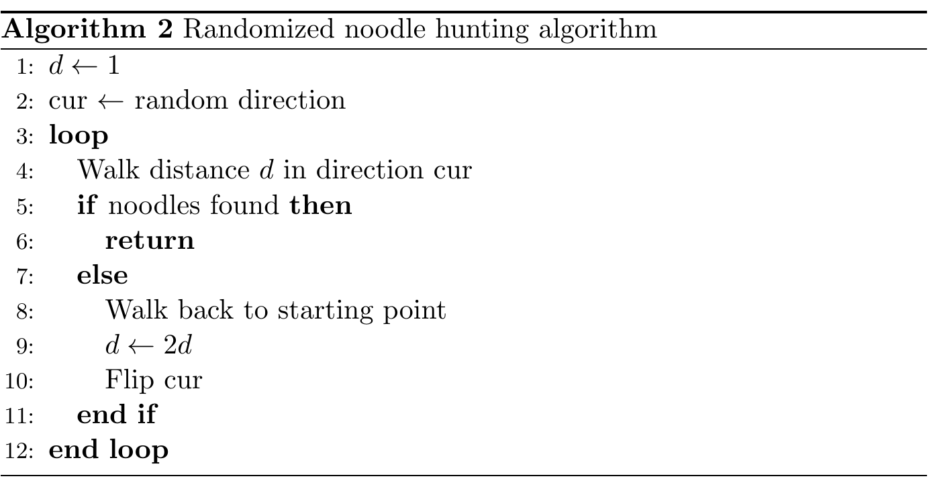

Slide 14
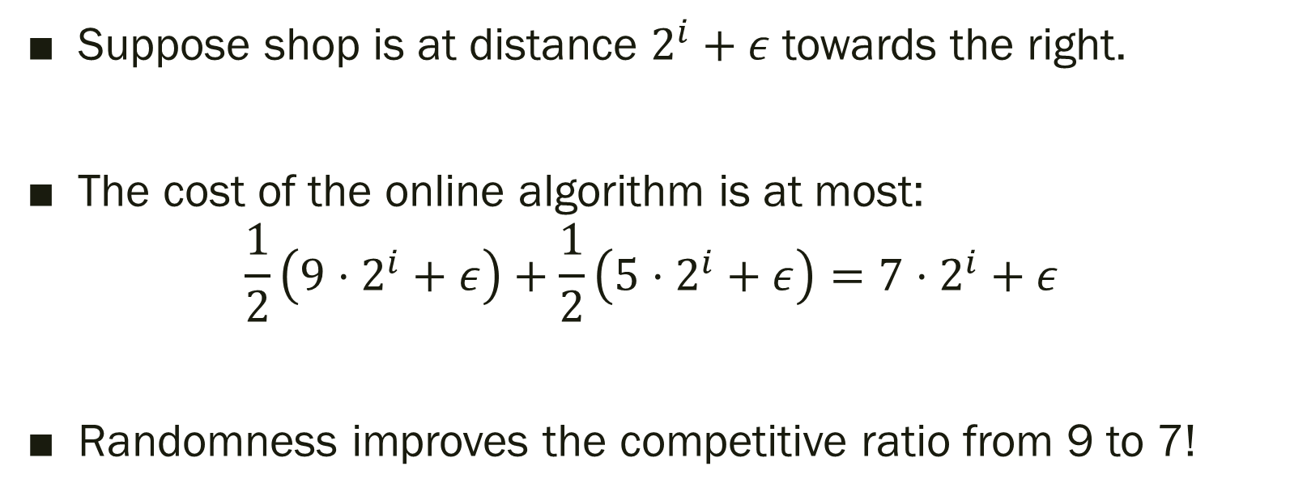
Randomized Noodle Hunting
Suppose shop is at distance $2^{i}+ε$ towards the right.
The cost of the online algorithm is at most:
$$\frac{1}{2}\left(9⋅2^{i}+ε\right)+\frac{1}{2}\left(5⋅2^{i}+ε\right)=7⋅2^{i}+ε$$
Randomness improves the competitive ratio from 9 to 7!

Slide 15

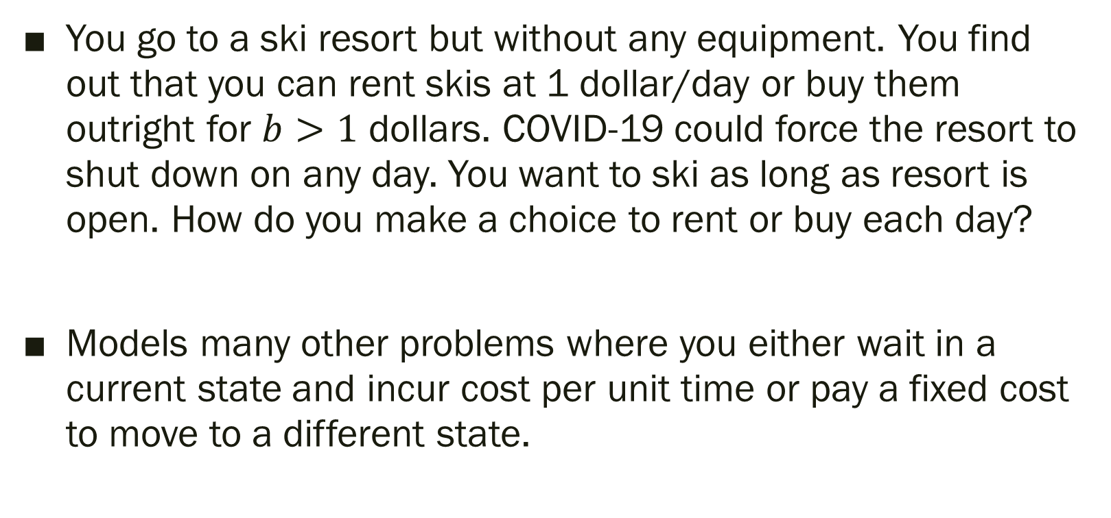
Ski Rental
You go to a ski resort but without any equipment. You find out that you can rent skis at 1 dollar/day or buy them outright for $b>1$ dollars. COVID-19 could force the resort to shut down on any day. You want to ski as long as resort is open. How do you make a choice to rent or buy each day?
Models many other problems where you either wait in a current state and incur cost per unit time or pay a fixed cost to move to a different state.

Slide 16
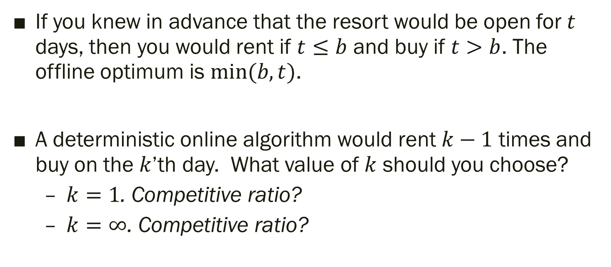
Ski Rental
If you knew in advance that the resort would be open for $t$ days, then you would rent if $t≤b$ and buy if $t>b$. The offline optimum is $min⁡(b,t)$.
A deterministic online algorithm would rent $k−1$ times and buy on the $k$’th day. What value of $k$ should you choose?
  $k=1$. Competitive ratio?
  $k=∞$. Competitive ratio?

Slide 17
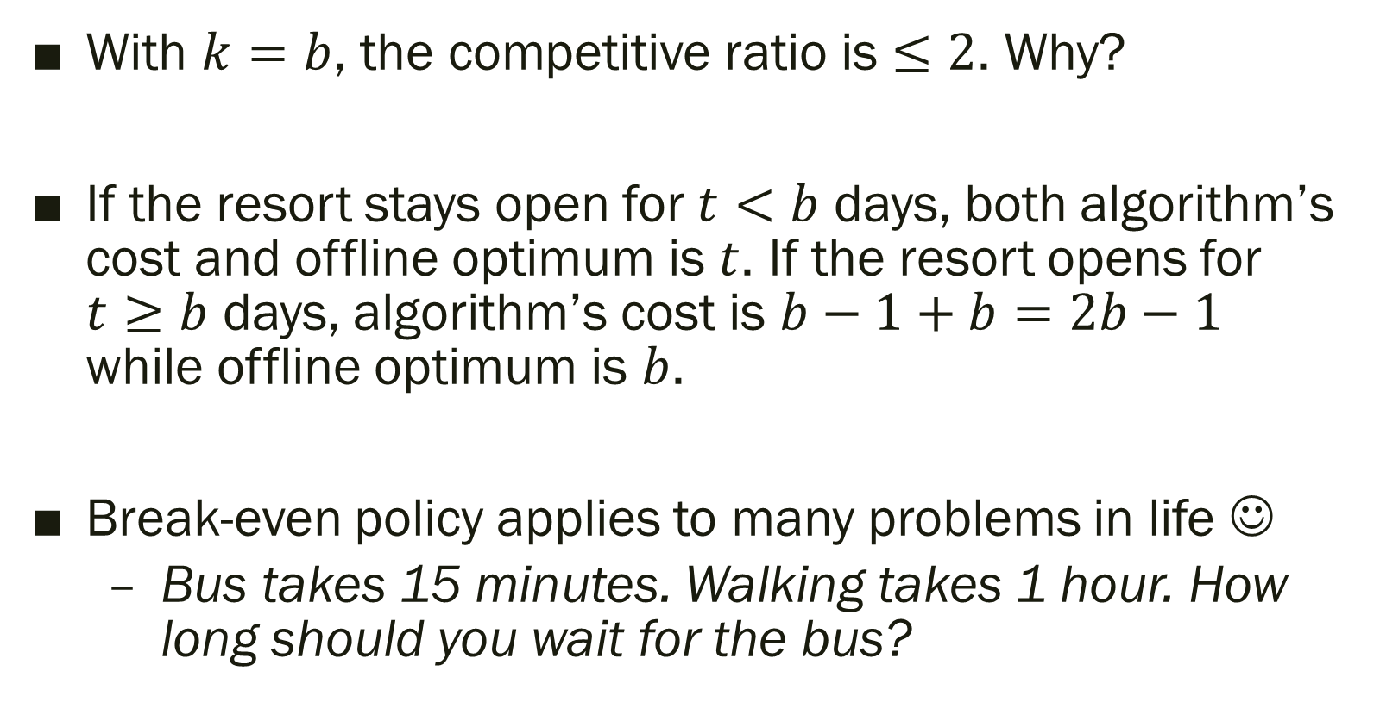
Break-Even
With $k=b$, the competitive ratio is $≤2$. Why?
If the resort stays open for $t<b$ days, both algorithm’s cost and offline optimum is $t$. If the resort opens for $t≥b$ days, algorithm’s cost is $b−1+b=2b−1$ while offline optimum is $b$.
Break-even policy applies to many problems in life ☺
  Bus takes 15 minutes. Walking takes 1 hour. How long should you wait for the bus?

Slide 18
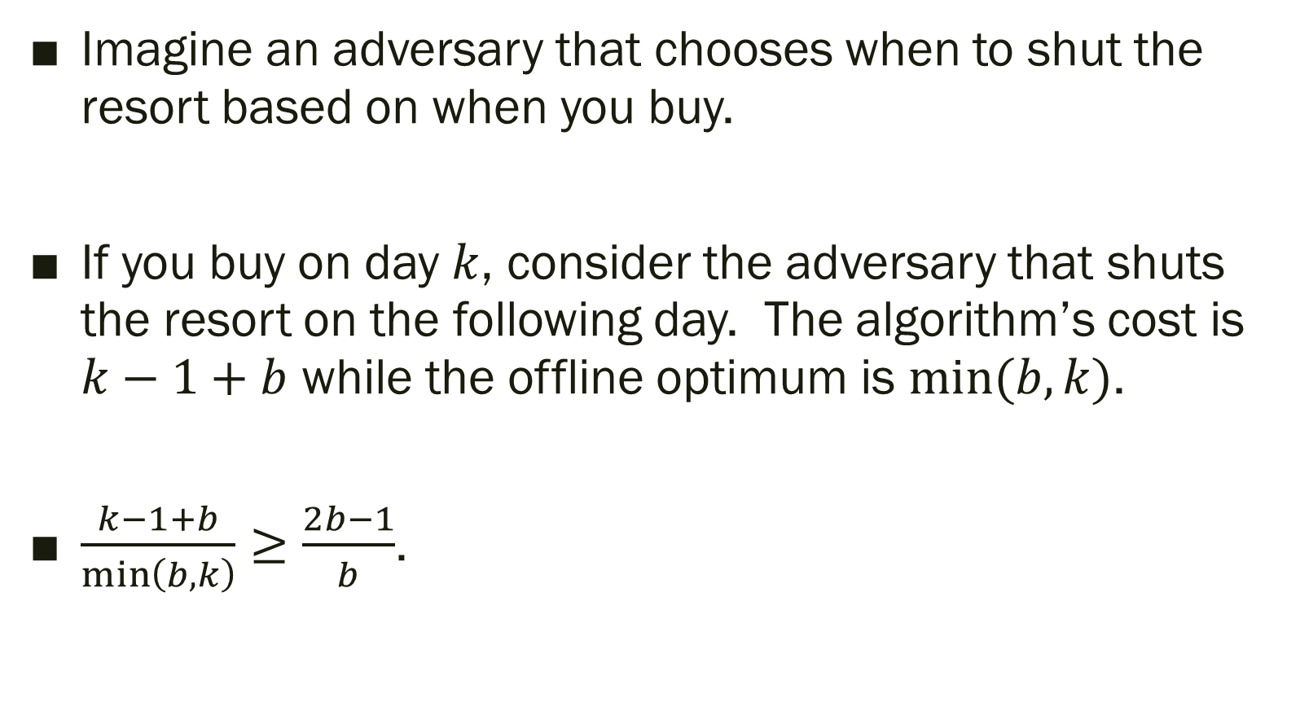
Optimal for deterministic algorithms
Imagine an adversary that chooses when to shut the resort based on when you buy.
If you buy on day $k$, consider the adversary that shuts the resort on the following day. The algorithm’s cost is $k−1+b$ while the offline optimum is $min⁡(b,k)$.
$\frac{k−1+b}{\min\left(b,k\right)}≥\frac{2b−1}{b}$.

Slide 19
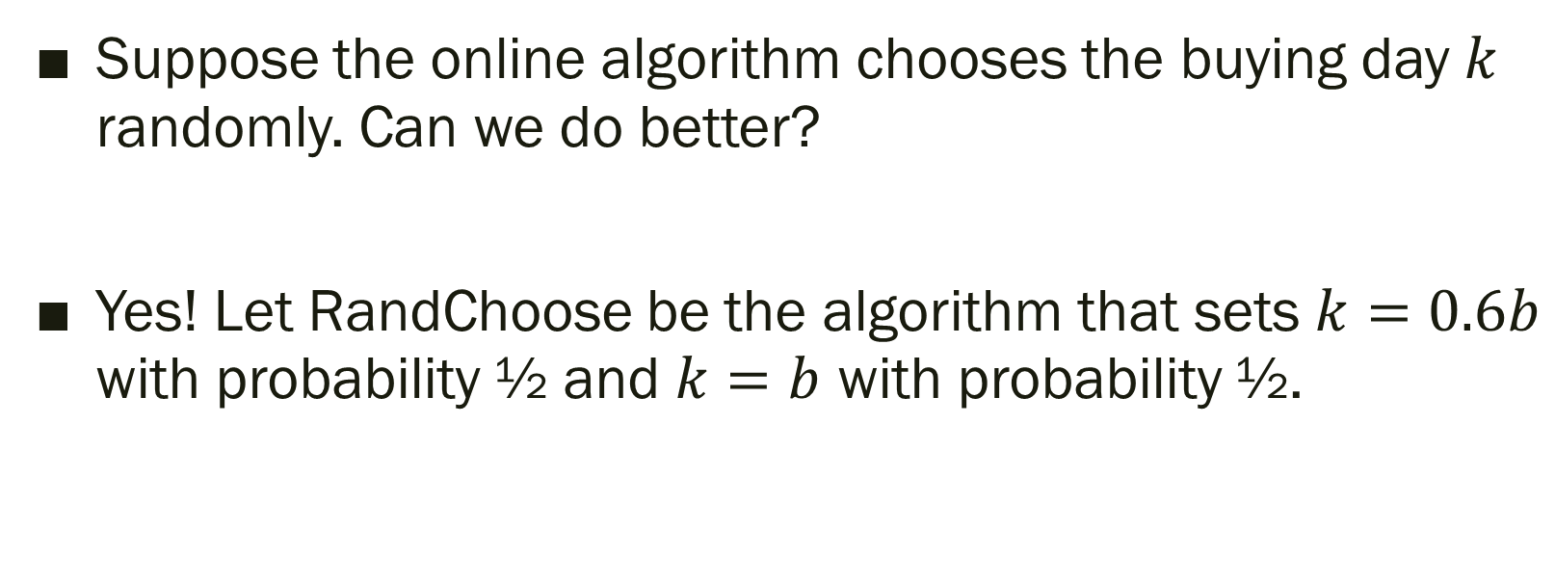
But what about randomized algorithms?
Suppose the online algorithm chooses the buying day $k$ randomly. Can we do better?
Yes! Let RandChoose be the algorithm that sets $k=0.6b$ with probability ½ and $k=b$ with probability ½.
Lemma: RandChoose has competitive ratio $≤11/6$

Slide 20
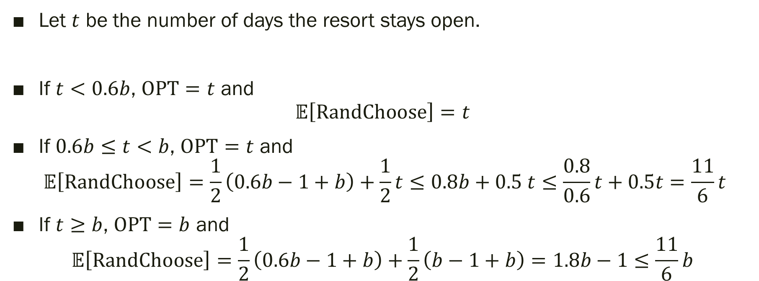
Analysis of RandChoose
Let $t$ be the number of days the resort stays open.
If $t<0.6b$, $\text{OPT}=t$ and
$𝔼\left[\text{RandChoose}\right]=t$
If $0.6b≤t<b$, $\text{OPT}=t$ and
$𝔼\left[\text{RandChoose}\right]=\frac{1}{2}\left(0.6b−1+b\right)+\frac{1}{2}t≤0.8b+0.5 t≤\frac{0.8}{0.6}t+0.5t=\frac{11}{6}t$
If $t≥b$, $\text{OPT}=b$ and
$𝔼\left[\text{RandChoose}\right]=\frac{1}{2}\left(0.6b−1+b\right)+\frac{1}{2}\left(b−1+b\right)=1.8b−1≤\frac{11}{6}b$

Slide 21
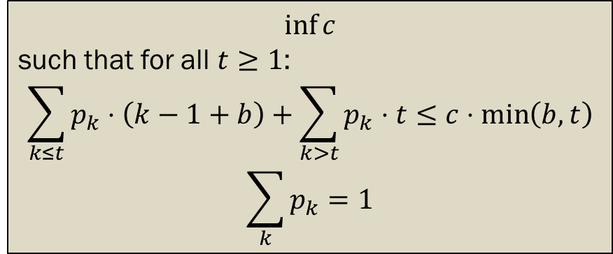
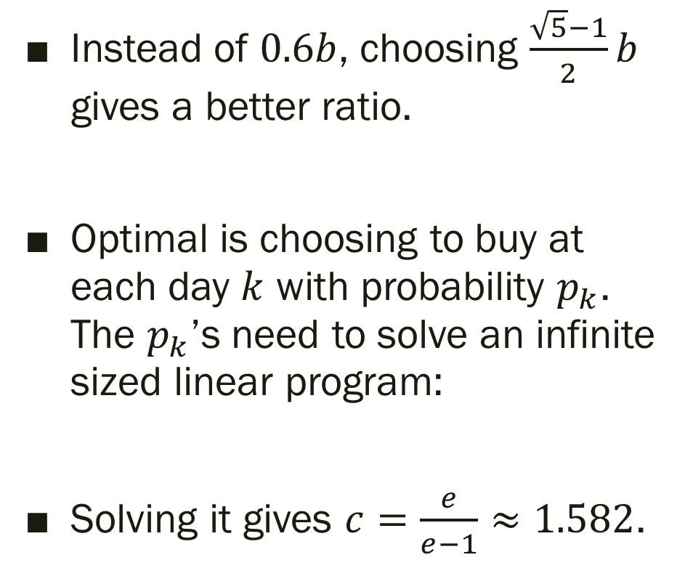
Doing even better
Instead of $0.6b$, choosing $\frac{\sqrt{5}−1}{2}b$ gives a better ratio.
Optimal is choosing to buy at each day $k$ with probability $p_{k}$. The $p_{k}$’s need to solve an infinite sized linear program:
Solving it gives $c=\frac{e}{e−1}≈1.582$.
$$\inf{c}$$
such that for all $t≥1$:
$$\sum_{k≤t}{p_{k}⋅\left(k−1+b\right)}+\sum_{k>t}{p_{k}⋅t}≤c⋅\min\left(b,t\right)$$
$$\sum_{k}{p_{k}}=1$$

Slide 22
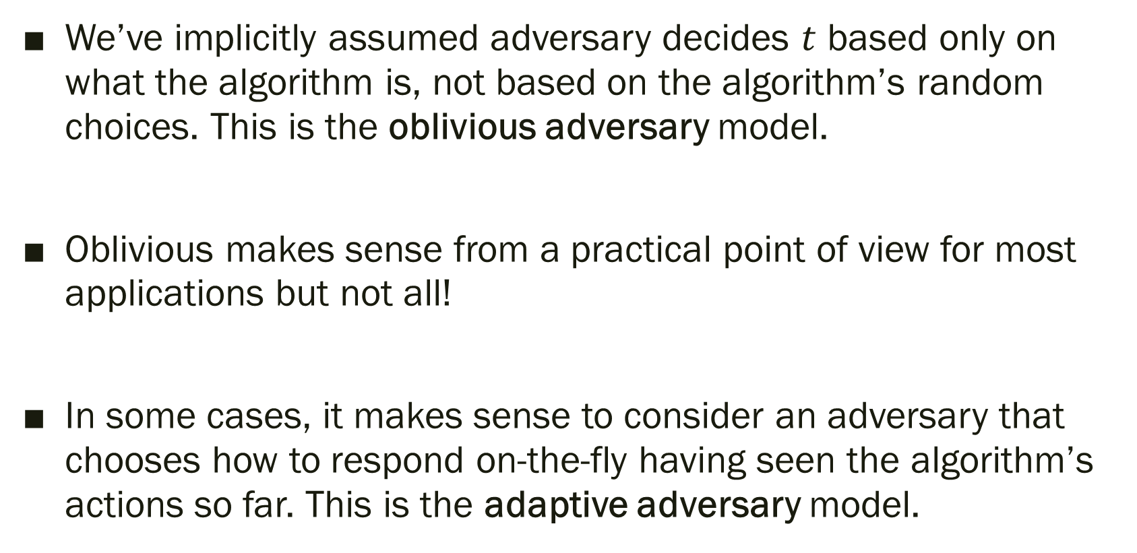
Aside: Adversary Model
We’ve implicitly assumed adversary decides $t$ based only on what the algorithm is, not based on the algorithm’s random choices. This is the oblivious adversary model.
Oblivious makes sense from a practical point of view for most applications but not all!
In some cases, it makes sense to consider an adversary that chooses how to respond on-the-fly having seen the algorithm’s actions so far. This is the adaptive adversary model.

Slide 23
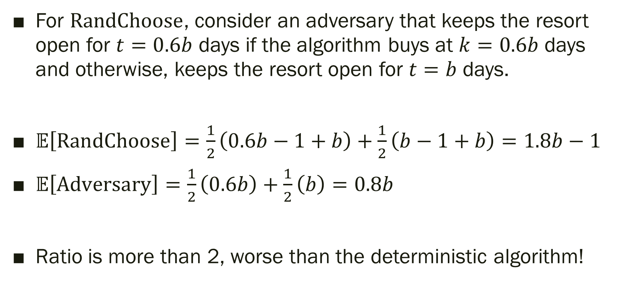
Example of an adaptive adversary
For $\text{RandChoose}$, consider an adversary that keeps the resort open for $t=0.6b$ days if the algorithm buys at $k=0.6b$ days and otherwise, keeps the resort open for $t=b$ days.
$𝔼\left[\text{RandChoose}\right]=\frac{1}{2}\left(0.6b−1+b\right)+\frac{1}{2}\left(b−1+b\right)=1.8b−1$
$𝔼\left[\text{Adversary}\right]=\frac{1}{2}\left(0.6b\right)+\frac{1}{2}\left(b\right)=0.8b$
Ratio is more than 2, worse than the deterministic algorithm!

Slide 24

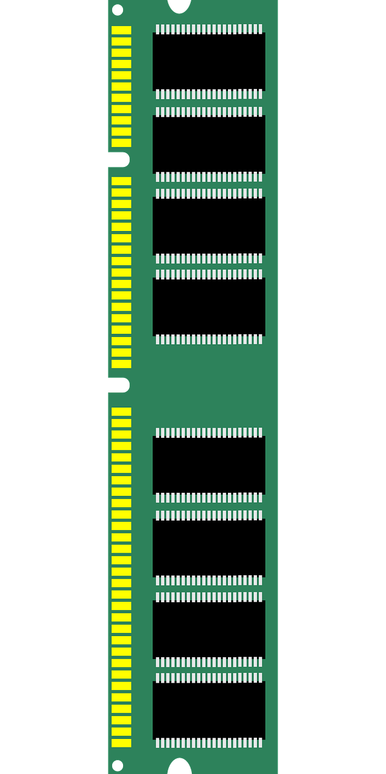
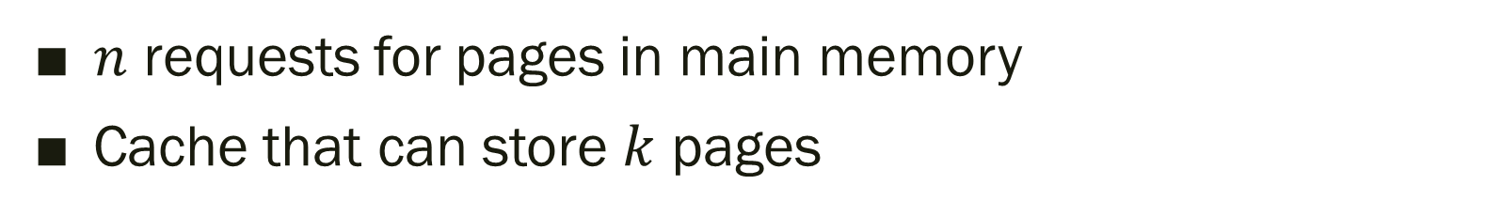
The paging problem
CPU
Cache
Main memory
Fast
Slow
$n$ requests for pages in main memory
Cache that can store $k$ pages

Slide 25
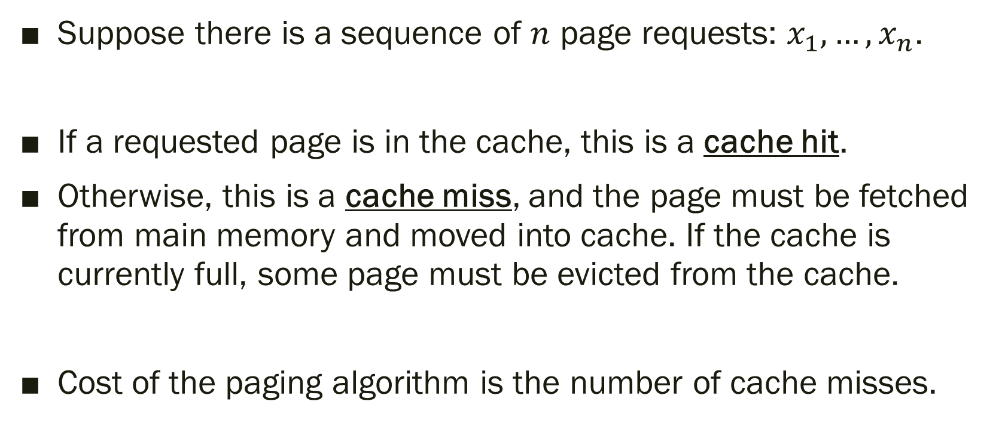
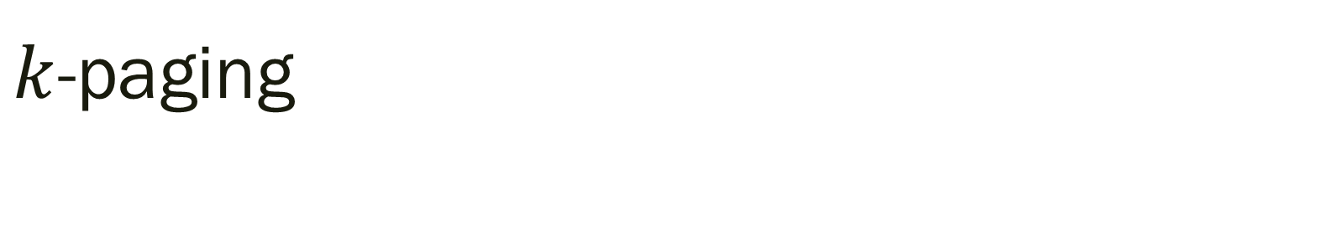
$k$-paging
Suppose there is a sequence of $n$ page requests: $x_{1},…, x_{n}$.
If a requested page is in the cache, this is a cache hit.
Otherwise, this is a cache miss, and the page must be fetched from main memory and moved into cache. If the cache is currently full, some page must be evicted from the cache.
Cost of the paging algorithm is the number of cache misses.

Slide 26
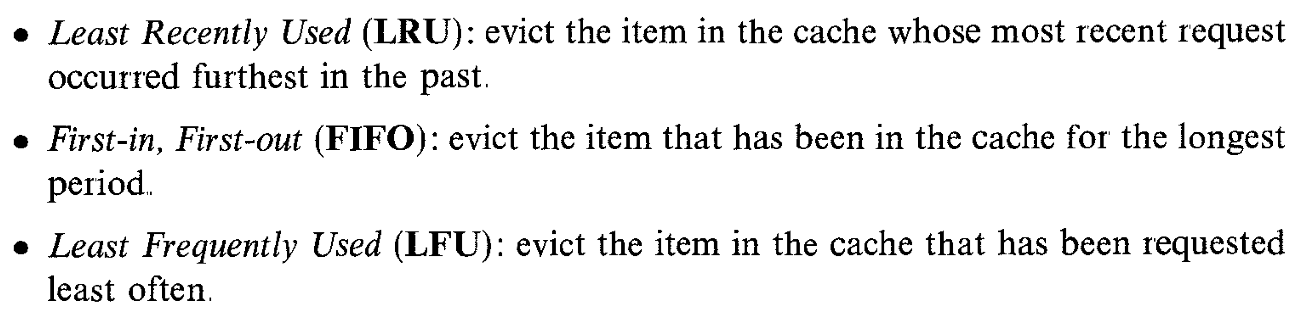
Popular paging algorithms
(MR, pg. 369)

Slide 27
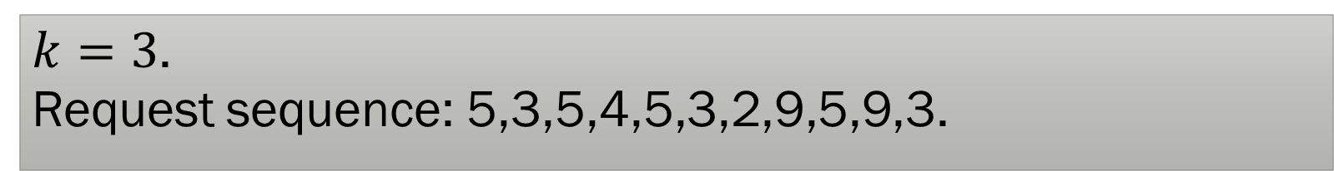
FIFO
$k=3$.
Request sequence: 5,3,5,4,5,3,2,9,5,9,3.

Slide 28
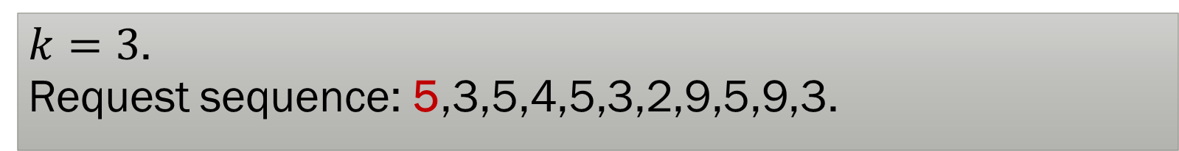
FIFO
$k=3$.
Request sequence: 5,3,5,4,5,3,2,9,5,9,3.
5
Cache misses: 1

Slide 29
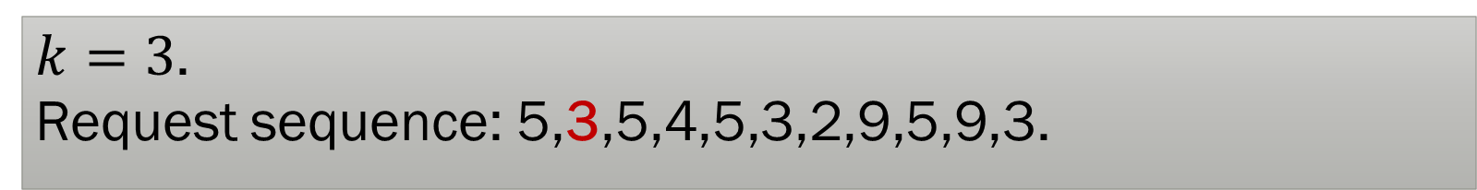
FIFO
$k=3$.
Request sequence: 5,3,5,4,5,3,2,9,5,9,3.
5 | 3
Cache misses: 2

Slide 30
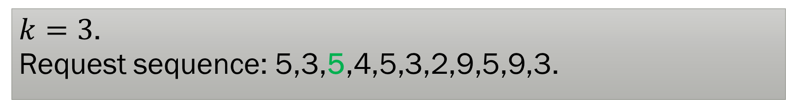
FIFO
$k=3$.
Request sequence: 5,3,5,4,5,3,2,9,5,9,3.
5 | 3
Cache misses: 2

Slide 31
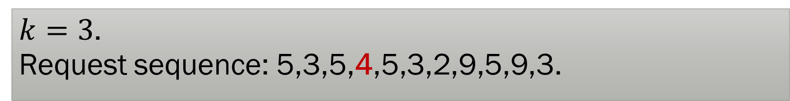
FIFO
$k=3$.
Request sequence: 5,3,5,4,5,3,2,9,5,9,3.
5 | 3 | 4
Cache misses: 3

Slide 32
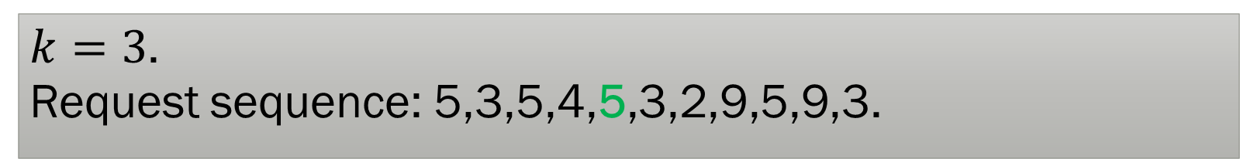
FIFO
$k=3$.
Request sequence: 5,3,5,4,5,3,2,9,5,9,3.
5 | 3 | 4
Cache misses: 3

Slide 33
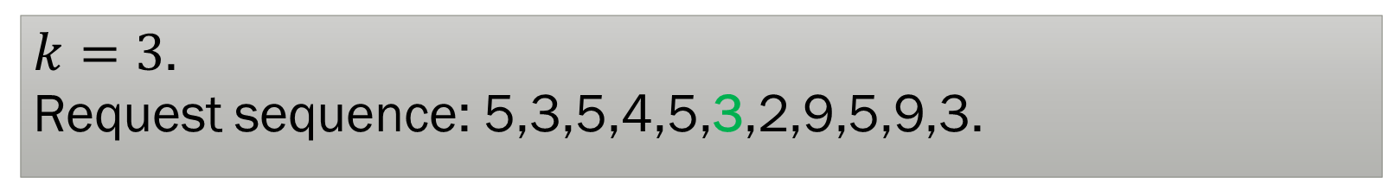
FIFO
$k=3$.
Request sequence: 5,3,5,4,5,3,2,9,5,9,3.
5 | 3 | 4
Cache misses: 3

Slide 34
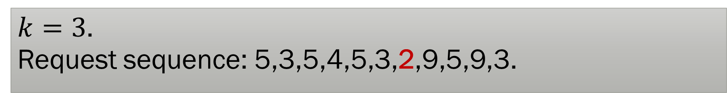
FIFO
$k=3$.
Request sequence: 5,3,5,4,5,3,2,9,5,9,3.
52 | 3 | 4
Cache misses: 4

Slide 35

FIFO
$k=3$.
Request sequence: 5,3,5,4,5,3,2,9,5,9,3.
2 | 39 | 4
Cache misses: 5

Slide 36

FIFO
$k=3$.
Request sequence: 5,3,5,4,5,3,2,9,5,9,3.
2 | 9 | 45
Cache misses: 6

Slide 37
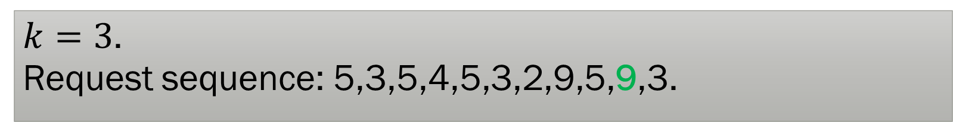
FIFO
$k=3$.
Request sequence: 5,3,5,4,5,3,2,9,5,9,3.
2 | 9 | 5
Cache misses: 6

Slide 38
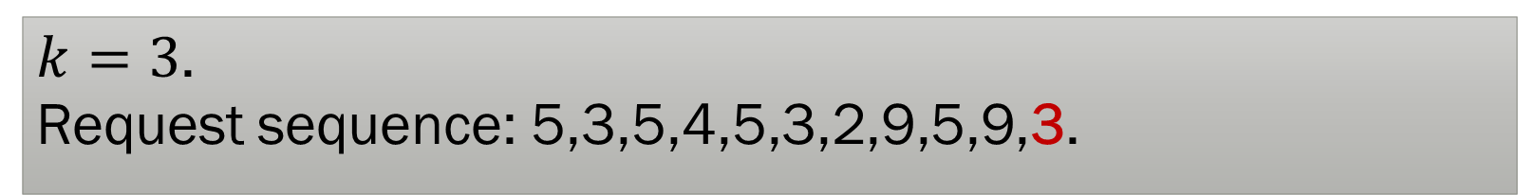
FIFO
$k=3$.
Request sequence: 5,3,5,4,5,3,2,9,5,9,3.
23 | 9 | 5
Cache misses: 7
Optimal # of cache misses: 5

Slide 39
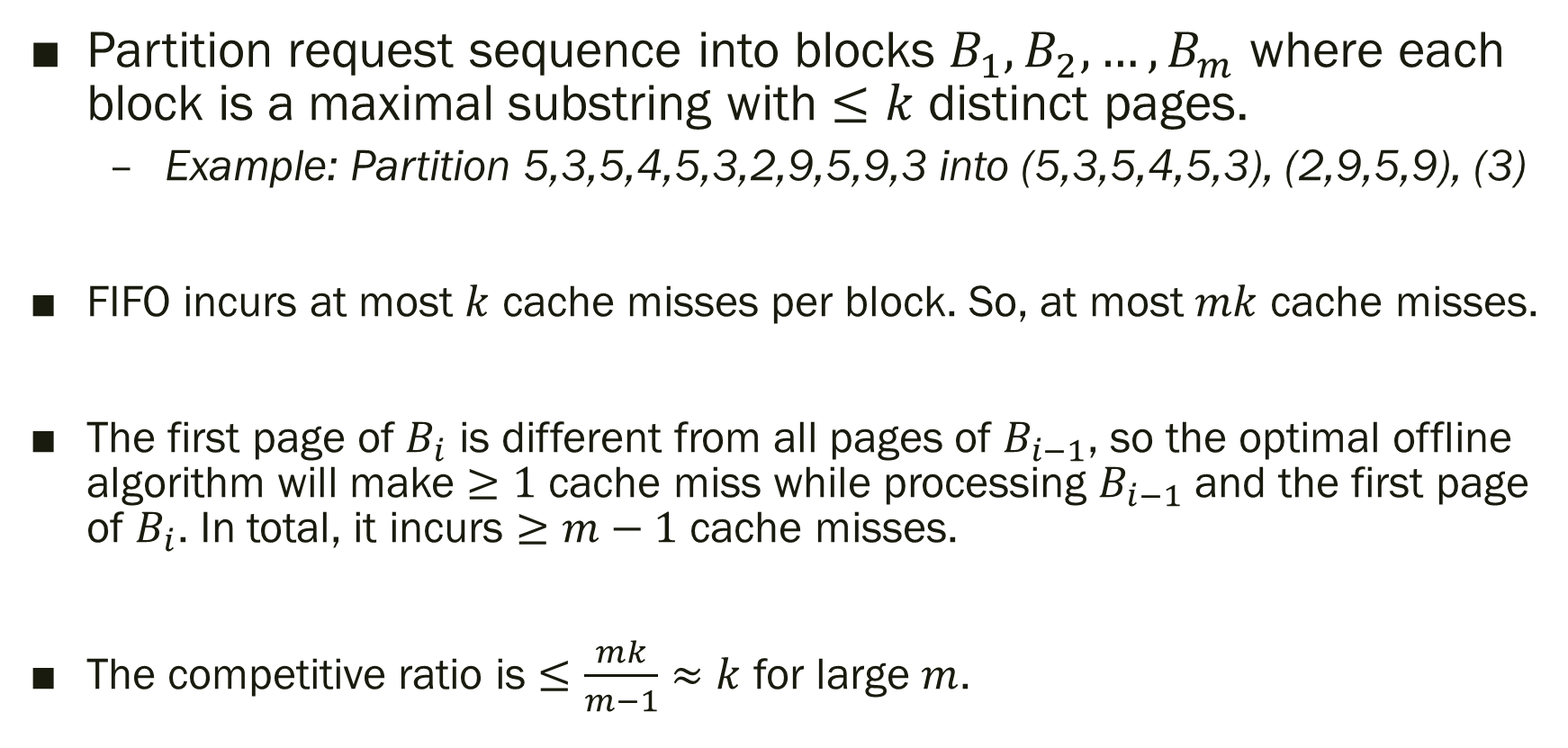
Competitive ratio of FIFO
Partition request sequence into blocks $B_{1},B_{2}, …, B_{m}$ where each block is a maximal substring with $≤k$ distinct pages.
  Example: Partition 5,3,5,4,5,3,2,9,5,9,3 into (5,3,5,4,5,3), (2,9,5,9), (3)
FIFO incurs at most $k$ cache misses per block. So, at most $mk$ cache misses.
The first page of $B_{i}$ is different from all pages of $B_{i−1}$, so the optimal offline algorithm will make $≥1$ cache miss while processing $B_{i−1}$ and the first page of $B_{i}$. In total, it incurs $≥m−1$ cache misses.
The competitive ratio is $≤\frac{mk}{m−1}≈k$ for large $m$.

Slide 40
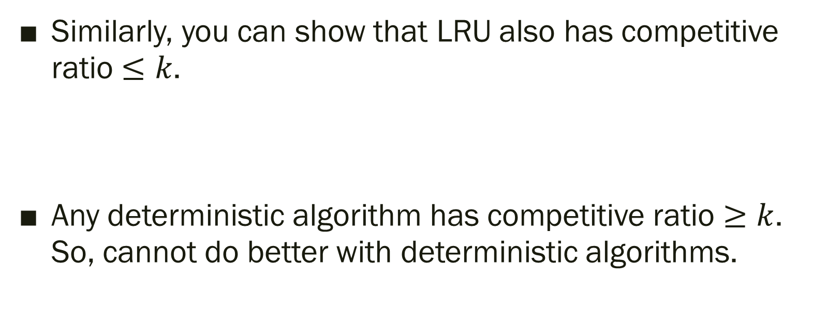
Optimality for deterministic algorithms
Similarly, you can show that LRU also has competitive ratio $≤k$.
Any deterministic algorithm has competitive ratio $≥k$. So, cannot do better with deterministic algorithms.

Slide 41
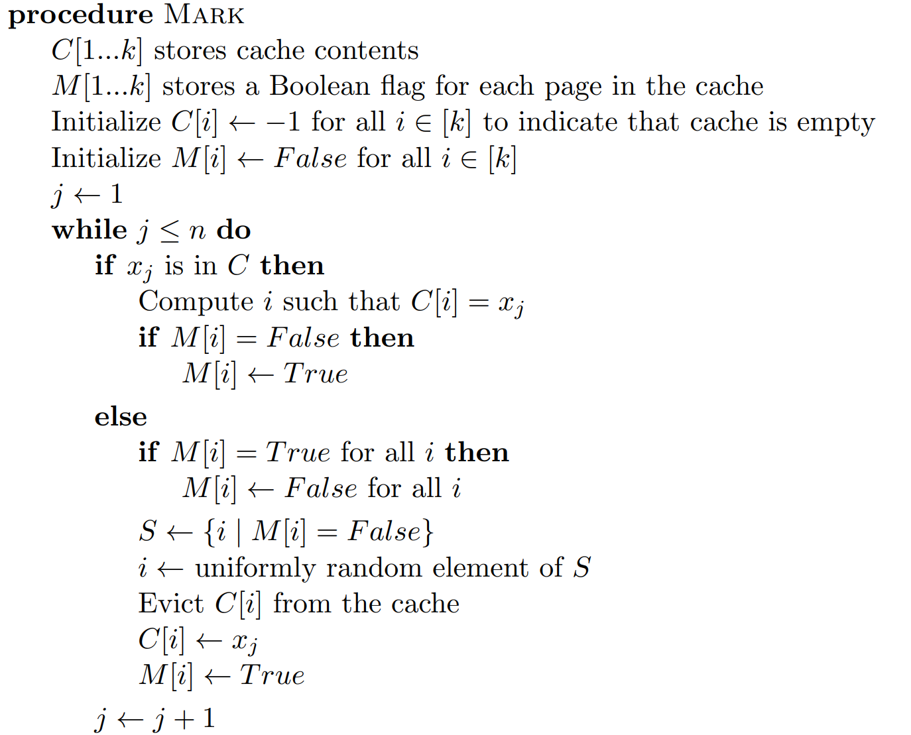
Randomized Marker Algorithm
Each cache page tagged with a marker bit
Initially, all unmarked
If cache hit, page is marked
If cache miss and all pages marked, then all get unmarked
Choose a page uniformly at random from unmarked pages, evict it, new page stored and marked.

Slide 42
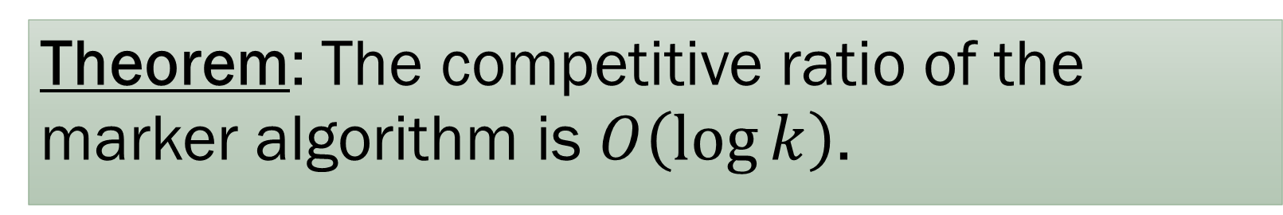
Randomized Marker Algorithm
Theorem: The competitive ratio of the marker algorithm is $O\left(\log{k}\right)$.

Slide 43

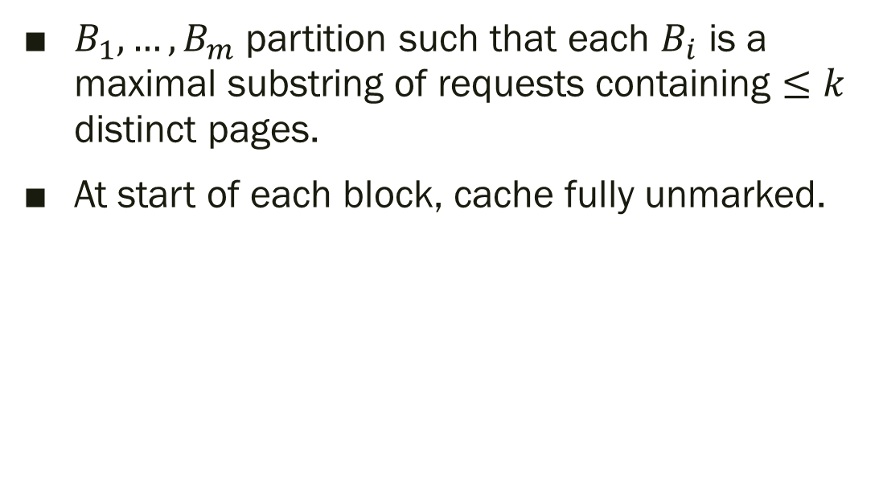

$$B_{i−1}$$
$$B_{i}$$
$B_{1},…, B_{m}$ partition such that each $B_{i}$ is a maximal substring of requests containing $≤k$ distinct pages.
At start of each block, cache fully unmarked.

Slide 44
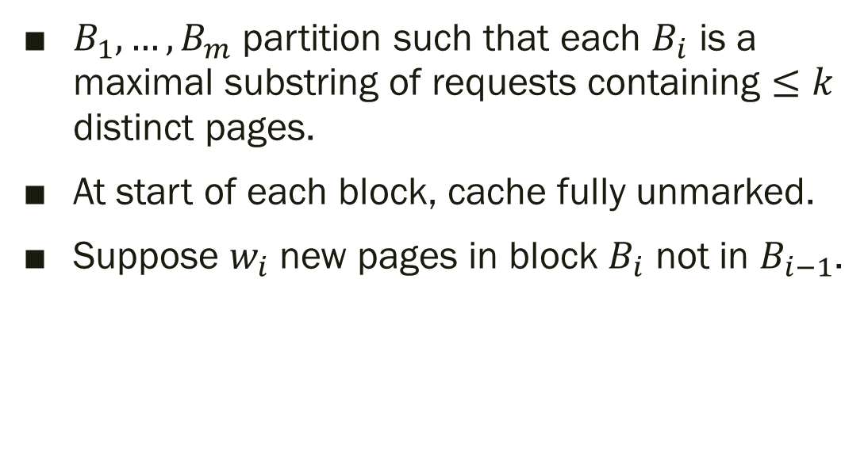


$$B_{i−1}$$
$$w_{i}$$
$$B_{i}$$
$B_{1},…, B_{m}$ partition such that each $B_{i}$ is a maximal substring of requests containing $≤k$ distinct pages.
At start of each block, cache fully unmarked.
Suppose $w_{i}$ new pages in block $B_{i}$ not in $B_{i−1}$.

Slide 45
$$B_{i−1}$$
$$w_{i}$$
$$B_{i}$$
$B_{1},…, B_{m}$ partition such that each $B_{i}$ is a maximal substring of requests containing $≤k$ distinct pages.
At start of each block, cache fully unmarked.
Suppose $w_{i}$ new pages in block $B_{i}$ not in $B_{i−1}$.

Slide 46
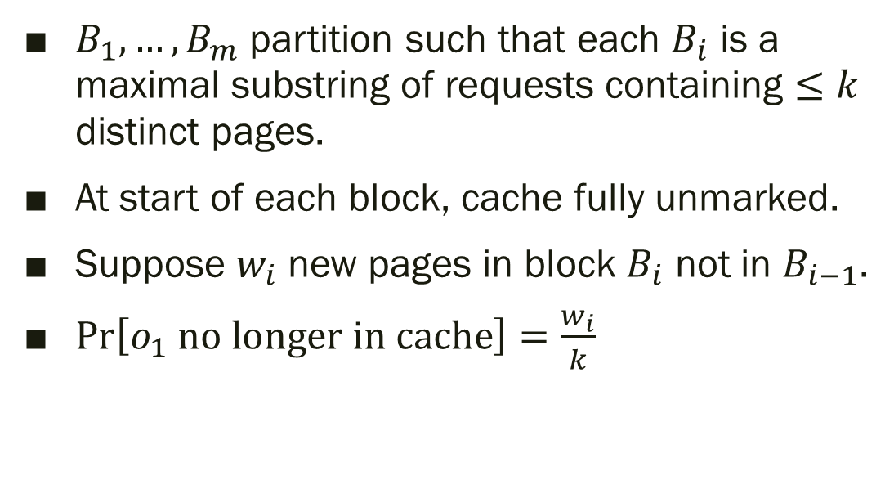

$$B_{i−1}$$
$$w_{i}$$
$$B_{i}$$
$$o_{1}$$
$B_{1},…, B_{m}$ partition such that each $B_{i}$ is a maximal substring of requests containing $≤k$ distinct pages.
At start of each block, cache fully unmarked.
Suppose $w_{i}$ new pages in block $B_{i}$ not in $B_{i−1}$.
$\operatorname{Pr}\left[o_{1} \text{no} \text{longer} \text{in} \text{cache}\right]=\frac{w_{i}}{k}$

Slide 47
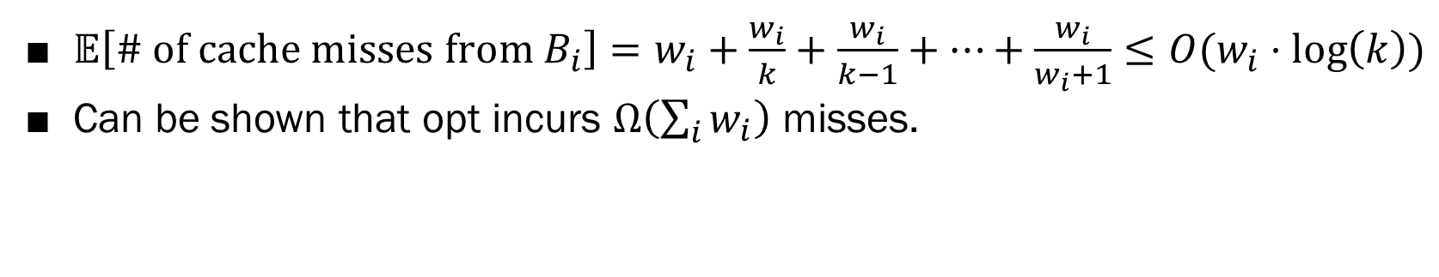

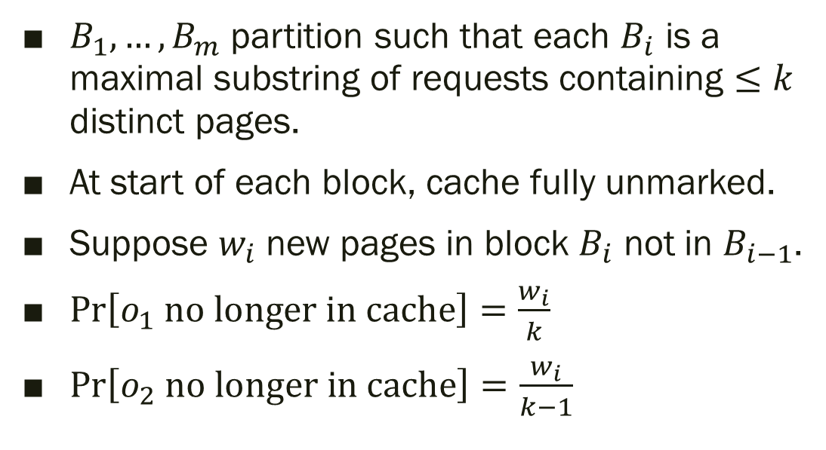
$$B_{i−1}$$
$$w_{i}$$
$$B_{i}$$
$$o_{1}$$
$$o_{2}$$
$B_{1},…, B_{m}$ partition such that each $B_{i}$ is a maximal substring of requests containing $≤k$ distinct pages.
At start of each block, cache fully unmarked.
Suppose $w_{i}$ new pages in block $B_{i}$ not in $B_{i−1}$.
$\operatorname{Pr}\left[o_{1} \text{no} \text{longer} \text{in} \text{cache}\right]=\frac{w_{i}}{k}$
$\operatorname{Pr}\left[o_{2} \text{no} \text{longer} \text{in} \text{cache}\right]=\frac{w_{i}}{k−1}$
$𝔼\left[\text{\# }\text{of} \text{cache} \text{misses} \text{from} B_{i}\right]=w_{i}+\frac{w_{i}}{k}+\frac{w_{i}}{k−1}+⋯+\frac{w_{i}}{w_{i}+1}≤O(w_{i}⋅\log\left(k\right))$
Can be shown that opt incurs $Ω\left(\sum_{i}{w_{i}}\right)$ misses.

Slide 48
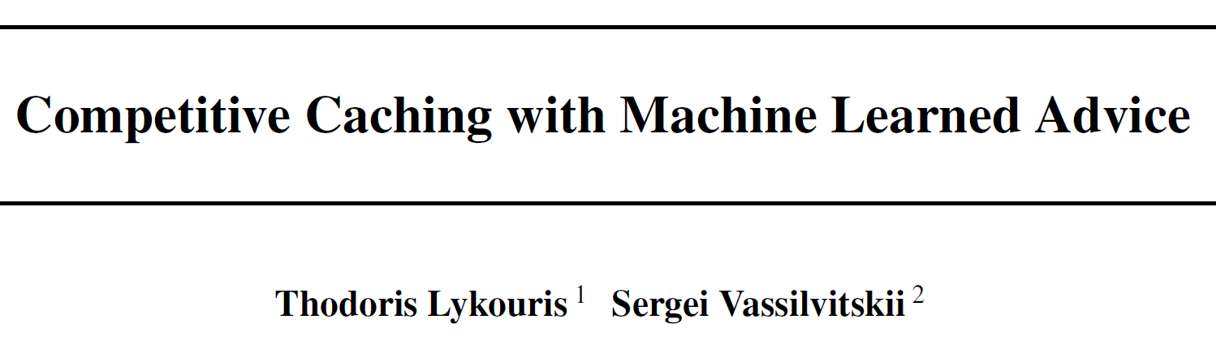
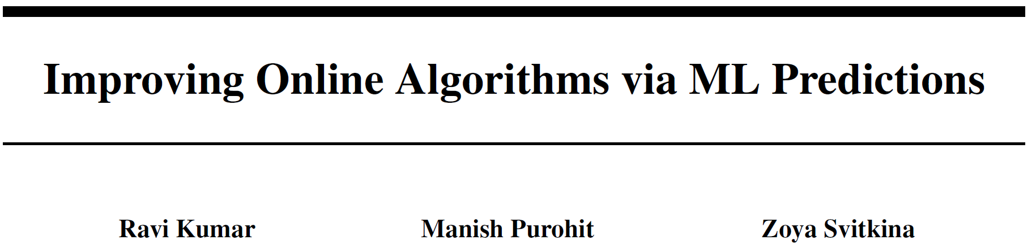
Final words about paging
Turns out that competitive ratio does not really capture the real world. LRU is still the gold standard in practice!
It is also of interest in this setting to look at adaptive adversaries. See MR.
Recent trend to combine competitive analysis with machine learning models that predict the next time a page will appear.

Slide 49
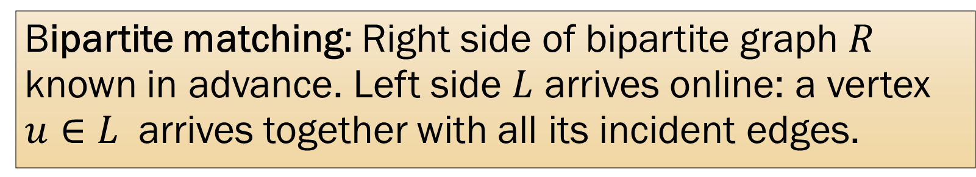
More problems: bipartite matching
Bipartite matching: Right side of bipartite graph $R$ known in advance. Left side $L$ arrives online: a vertex $u∈L$ arrives together with all its incident edges.
Webpage visitors
Internet advertisements

Slide 50
More problems: bipartite matching
Bipartite matching: Right side of bipartite graph $R$ known in advance. Left side $L$ arrives online: a vertex $u∈L$ arrives together with all its incident edges.
Webpage visitors
Internet advertisements

Slide 51
More problems: bipartite matching
Bipartite matching: Right side of bipartite graph $R$ known in advance. Left side $L$ arrives online: a vertex $u∈L$ arrives together with all its incident edges.
Webpage visitors
Internet advertisements

Slide 52
More problems: bipartite matching
Bipartite matching: Right side of bipartite graph $R$ known in advance. Left side $L$ arrives online: a vertex $u∈L$ arrives together with all its incident edges.
Webpage visitors
Internet advertisements

Slide 53
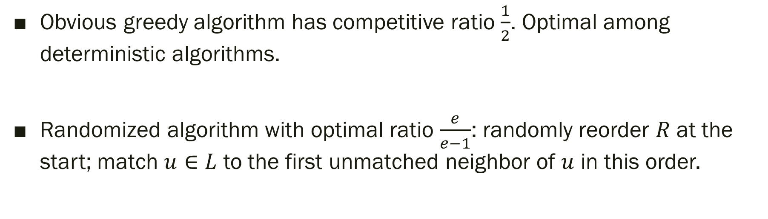
More problems: bipartite matching
Bipartite matching: Right side of bipartite graph $R$ known in advance. Left side $L$ arrives online: a vertex $u∈L$ arrives together with all its incident edges.
Obvious greedy algorithm has competitive ratio $\frac{1}{2}$. Optimal among deterministic algorithms.
Randomized algorithm with optimal ratio $\frac{e}{e−1}$: randomly reorder $R$ at the start; match $u∈L$ to the first unmatched neighbor of $u$ in this order.

Slide 54
Summary: Online algorithms
Randomization in the decision process often helps in foiling adversaries, even adaptive ones.
Online algorithms were first studied in the late 1980’s-90’s, but they have enjoyed a renaissance lately with new applications and new techniques.
One of these new techniques is using ideas from online learning.

Slide 55
What is online learning?
Example: Suppose you work at a hospital, and your job is to predict the birth weight of babies from their fetal measurements. Each time you make a prediction, you later find out the true birth weight, and you earn a bonus depending on how far you were from the truth.
Online learning vs. Online algorithms:
Cost model: Online learner doesn’t know the cost at prediction time (only later after true answer is revealed). An online algorithm (e.g., bipartite matching) knows the cost for each decision it makes (e.g., whether it matches current vertex or not).
Performance metric: In online learning, regret is the difference between the total loss incurred by algorithm and total loss incurred by optimal predictor. In online algorithms, you measure competitive ratio.

Slide 56
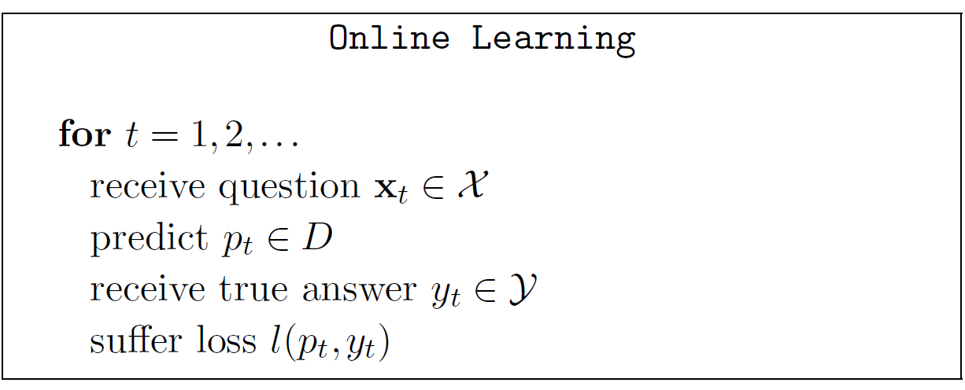
Online Learning

Slide 57
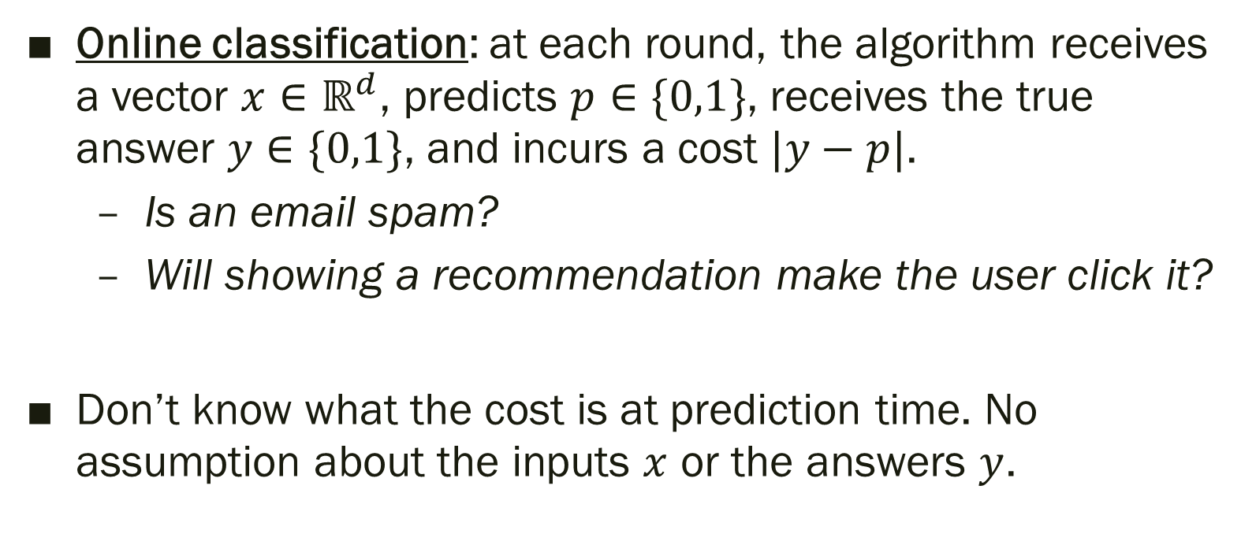
Online Classification
Online classification: at each round, the algorithm receives a vector $x∈ℝ^{d}$, predicts $p∈\{0,1\}$, receives the true answer $y∈\{0,1\}$, and incurs a cost $|y−p|$.
  Is an email spam?
  Will showing a recommendation make the user click it?
Don’t know what the cost is at prediction time. No assumption about the inputs $x$ or the answers $y$.

Slide 58

Impossibility
In general, nothing non-trivial can be done.
  An adversary can make the “true answer” be the opposite of the “prediction”. So, the loss incurred at each step is 1. Total loss is $T$ in $T$ steps.
Two workarounds:
  Hypothesis class: Compare algorithm’s prediction against the best possible predictor from a class $ℋ$.
  Randomization: Allow algorithm to be probabilistic. Its prediction at each step is a random variable.

Slide 59


Algorithm for Online Classification
Suppose we have a hypothesis class consisting of $d$ classifiers $h_{1},…, h_{d}$. If we allow classifier output to be probabilistic…

Slide 60

Theorem: The weighted majority algorithm satisfies regret bound:
$$𝔼[\#\text{misclassifications}]−\min_{h∈\left\{h_{1},…, h_{d}\right\}}{\sum_{t=1}^{T}{\left|h\left(x_{t}\right)−y_{t}\right|}}≤\sqrt{\frac{T\ln{d}}{2}}$$

Slide 61
Takeaways
Area of online learning makes no statistical assumptions about the origin of examples. Performance measured as regret instead of competitive ratio.
Deep connections with convex optimization. This area is of high importance currently due to applications to modern machine learning.

